Slide 1
THE LURE OF THE DANCE
“Make it a law, never to be repealed, that the men must dance by themselves and the women dance by themselves—no intermingling of the sexes—and this graceful, health-improving? ‘exercise’ will die a natural death. Out and out sinners, whether merely moral or genuine libertines , will acknowledge that it is the intermingling of the sexes that gives life to the dance—not the exercise to be enjoyed in it, and it always has been a puzzle to me why so many church members take such pains to defend it. A really innocent pleasure needs no defense.”

Slide 2
“The Lure Of The Dance,”
p. 63, © 1916, 1919.
T. A. Faulkner (former dancing master and proprietor of the Los Angeles Dancing Academy and president of Dancing Masters’ Association of the Pacific Coast)

Slide 3
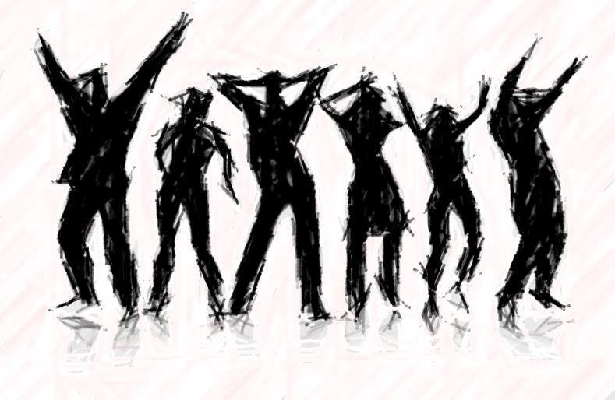
Is Modern Dancing Acceptable Entertainment For The Christian?
Part 1
All verses are from the New King James Version unless noted.

Slide 4
Some Say:
“I don’t see any harm in it.”
Yet things that are truly good, we would never say or ask “Is there any harm in it?”
Notes:
E.G., Not a question of “harm in”, coming to church, attending Bible study, visiting those who are in need. But when it comes to some things like smoking, social drinking, mini-skirts, viewing porn, some ask “is there any harm in it?”

Slide 5
One Ranted:
“people need to learn to attend to their own lives and stay out of others....it's called being a busybody” (Actual FB comment from a mother defending daughter’s right to participate in swing-dance class, Feb. 2010)
Example of why warnings exists in scripture against the hardening effect of sin (Heb. 3:13; 2 Tim. 4:3; etc.)
What about warning against other like sins (drinking, immodesty, smoking, drugs, etc.)?
Notes:
Has not learned that a busybody does not warn people against sin is in sin.

Slide 6
“Kids (along with some parents) enter the building. Now before they can enter they must have modest dress on and if they don’t they are not allowed to enter. Before anything begins they go over the rules (this is done every time)…There is to be no touching of the body other than the hands. There is no gyrating of the hips or the chest…If there are any problems they are asked to leave. They do not dance with one sole person. If anyone is acting weird to either the girl or the guy that person that is offended goes to the adult and they (the guilty) are confronted and escorted out...After all the rules have been said to all, then they open up in prayer (yes, done by someone not in the church of Christ but one that believes that there is a God)”
(Email of a permissive father justifying the decision to let his daughter participate in swing-dance classes, 2/12/2010)

Slide 7
“The way of a fool is right in his own eyes, But he who heeds counsel is wise” (Prov. 12:15)
If dancing is a “pure” activity, why do parents need to chaperon the class?
The world doesn’t know how to define modest dress
Notes:
Slippery slope is where you get to the edge of sin and begin sliding down headlong where other sins multiply. There is often a cascading effect of sin. Ahab wanted a vineyard which was not his. He coveted it. He then became greatly displeased when he could not buy it. He became unthankful for what he already had. He then pouted which got Jezebel involved where lying, murder and stealing eventually unfolded.

Slide 8
“The way of a fool is right in his own eyes, But he who heeds counsel is wise” (Prov. 12:15)
Such parents send their children to a slippery slope
X
Dance!
Y
Jeremiah 23:11-14
Ecclesiastes 10:8
1 Kings 21:1-15
2 Samuel 11:1-17
Z
Notes:
Slippery slope is where you get to the edge of sin and begin sliding down headlong where other sins multiply. Asaph nearly slid away by becoming envious of the boastful (Ps. 73:1-17). Jeremiah warned of this slippery slide which false teachers had made (Jer. 23:11-14). There are other like expressions which convey the same or a similar type of expression (see Eccl. 10:8; Prov. 26:27).
There is often a cascading effect of sin. Ahab wanted a vineyard which was not his. He coveted it. He then became greatly displeased when he could not buy it. He became unthankful for what he already had. He then pouted which got Jezebel involved where lying, murder and stealing eventually unfolded.

Slide 9
“The way of a fool is right in his own eyes, But he who heeds counsel is wise” (Prov. 12:15)
Prayer never sanctifies a sinful action
A preacher who is “of Christ” would never open such a session up with “prayer,” but with rather “rebuke”

Slide 10
“The way of a fool is right in his own eyes, But he who heeds counsel is wise” (Prov. 12:15)
What rules are worth creating and repeating if the action being done is wrong?
Compare drinking/driving—1,412,223 were arrested for driving under influence in 2010 (http://www.fbi.gov)
No appeal for Bible authority
Notes:
Adding rules for modifying getting high or drinking beer do not make the practice good. How does that rule, “don’t drink and drive” working out for America? Nearly 11,000 people are killed every year with drunk drivers and 85 percent of these accidents involve those who went on a drinking binge, which includes 5 or more beers for men and 4 or more for women. Do the rules “don’t drink and drive” and the posting of rules about .08 percent Blood Alcohol level really solve the problem?

Slide 11
How Does THE BIBLE Answer Our Question?
“And whatever you do in word or deed, do all in the name of the Lord Jesus, giving thanks to God the Father through Him” (Col. 3:17)

Slide 12
Folly of isolated human reasoning to determine truth
“There is a way that seems right to a man, But its end is the way of death” (Prov. 14:12; cf. Rom. 6:21)
“There is a generation that is pure in its own eyes, Yet is not washed from its filthiness” (Prov. 30:12)
“Let no one deceive you with empty words, for because of these things the wrath of God comes upon the sons of disobedience” (Eph. 5:6)

Slide 13
Similar To The Subject of Bible Wine
The Bible recognizes good wine and sinful wine
It is not “moderation” but “content” of the cup which makes it evil or good
Wine As A BLESSING
Wine As A CURSE
Deut. 7:13; 11:14; Prov. 3:10; Eccl. 9:7; Is. 65:8; Hos. 2:8; etc.
Gen. 19:32; Prov. 20:1; 23:29-35; 31:4; Is. 5:11; Hos. 7:5; 1 Pet. 4:3; etc.
not intoxicating
intoxicating

Slide 14
Dancing?
1 To everything there is a season, A time for every purpose under heaven:
2 A time to be born, And a time to die; A time to plant, And a time to pluck what is planted;
3 A time to kill, And a time to heal; A time to break down, And a time to build up;
4 A time to weep, And a time to laugh; A time to mourn, And a time to dance;
5 A time to cast away stones, And a time to gather stones; A time to embrace, And a time to refrain from embracing
(Eccl. 3:1-5)

Slide 15
Juxtaposed Actions
Do not plant when it is time to pluck
The time to break down is not the time to build
The time to weep is not the time to laugh
The time to mourn is not the time to dance
“Dance” means “to skip about” (Online Bible Hebrew Lexicon)
cf. 1 Chron. 15:29, “whirling;” Job 21:11 “dance;” Ps. 29:6; 114:4, 6 “skip;” ; Is. 13:21, “caper;” Joel 2:5 “leap;” Nah. 3:2, “clattering”
Solomon had in mind an expression of joy
Not a social gathering for men to handle women, in show, competition, exercise or otherwise

Slide 16
To Know The Truth
We must accept what the Bible says
Accept all that the Bible says
Respecting the context of what the Bible says
Next lesson:
Examples of Bible dancing
New Testament warnings and principles

